Slide 1
CSCI 4061 Lab #13
April 25, 2022

Slide 2
Agenda
Exam #2 review
IPC: Message Passing and Shared Memory
Signals
Threads
Synchronization
Networking/Socket Programming
No Exercise

Slide 3
Message Passing
Sender puts messages into queue.
Receiver pulls the messages out of the queue.
POSIX API
msgget(): Create a message queue or connect to an already existing message queue
msgsnd(): Write into message queue
msgrcv(): Read from the message queue
msgctl(): Perform control operations on the message queue

Slide 4
Message Queue example
1. Create queue 4. Connect to the queue
sender
receiver
mtype = 4
4
Message Queue
4
Hi there
Hi there
3. Send msg
5. Receive msg
long mtype
2. Input from user
char
mtext[100]
6. Remove queue
Message

Slide 5
Shared Memory
Shared-memory allows two or more processes to share a segment of physical memory.
POSIX API
shmget(): create shared memory segment
shmat(): attach to the shared memory segment
shmdt(): detach from the shared memory segment
shmctl(): remove shared memory segment

Slide 6
Signals
Signals are a form of asynchronous IPC
Software interrupt to a process
Examples:
SIGABRT: Process abort
SIGINT: Ctrl-C
SIGSTOP: Execution stopped
SIGKILL/ SIGTERM: Terminated
SIGCHLD: Child exited
Send signals using kill()

Slide 7
Handling Signals
Default action (most cases will cause termination)
Ignore (protect against ^C)
Block signals : queued in OS
The process receives the signal only after it is unblocked
sigprocmask()
Take specific action/handle
Associate an action on delivery of signal
sigaction()

Slide 8
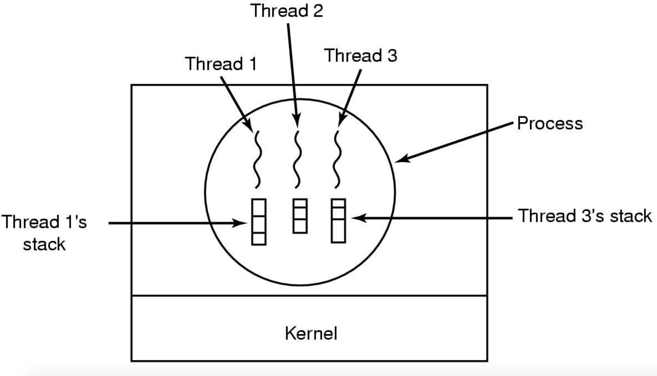
Threads
An abstraction for an executing instruction stream
Multiple threads share resources within a process.
– Have their own stacks
Joinable threads and detachable threads

Slide 9
Threads: Benefits and Drawbacks
Benefits:
Concurrency: multiple pieces of code can be executed simultaneously
Modularity: decompose functionality
Parallelism: threads running in parallel (multi-core)
Scale: more threads available than processors
Overhead: multiple threads cheaper than multiple processes
Drawbacks:
Sharing and thread safety: requires synchronization
Global variables: per thread global variables may be required

Slide 10
Threads POSIX API
pthread_create(): create a thread
pthread_self(): identify the calling thread
pthread_equal(): compare two threads
pthread_exit(): exit the thread
pthread_cancel(): cancel a thread
pthread_join(): wait for a joinable thread to complete

Slide 11
Synchronization: Locks
Mutex is a lock that we set before using a shared
resource and release after using it.
- This helps in synchronization
POSIX API:
pthread_mutex_init(): initializes the lock
pthread_mutex_lock(): acquire lock if available else wait until available
pthread_mutex_unlock(): release the lock

Slide 12
Condition Variables
Method of blocking while waiting for a condition to be satisfied
A thread blocks itself when the condition is false
A different thread wakes it when the condition is true
POSIX API:
pthread_cond_init(): initialize a condition variable
pthread_cond_wait(): wait on a condition variable
pthread_cond_signal(): signal one thread waiting on that condition variable
pthread_cond_broadcast(): signal all threads waiting on that condition variable

Slide 13
Semaphores
Does not require busy waiting.
POSIX API:
sem_init(): initialize a semaphore
sem_wait(): wait on a semaphore / decrement
sem_post(): post to a semaphore / increment

Slide 14
Networking
Enable communication between processes on different machines.
Socket –abstraction of a communication endpoint
Process sends/receives messages to/from its socket
Transport protocols
TCP: Connection-oriented, reliable
UDP: Connectionless, unreliable

Slide 15
Client-Server Architecture
Server process waits to be contacted
Client process initiates communication

Slide 16
Server side
Create socket
Bind to the socket
Listen
Accept
Send/Recv

Slide 17
Client Side
Create socket
Connect
Send/Recv

Slide 18
POSIX API
int socket(int domain, int type, int protocol): Creates a socket
int bind(int sockfd, const struct sockaddr *addr socklen_t addrlen)
Bind the socket to a network address
int listen(int sockfd, int backlog): Listen for incoming connection requests
int accept(int sockfd, struct sockaddr *addr, socklen_t *addrlen)
Accept a new connection, blocks until a new request arrives.
int connect(int sockfd, const struct sockaddr *addr socklen_t addrlen)
Connect to the server
ssize_t sendto(int sockfd, const void *buf, size_t len, int flags const struct
sockaddr *dest_addr, socklen_t addrlen): Send data
ssize_t recvfrom(int sockfd, void *buf, size_t len, int flags struct sockaddr
*src_addr, socklen_t *addrlen): Receive data

Slide 19
Questions?

Slide 20
Thank you! All the best!

